Slide 1
H
E
A
R
T
Disease Prediction
Intruders

Slide 2
CONTENTS
Abstract
Introduction
Model
Conclusion

Slide 3
Abstract

Slide 4
Abstract
Heart disease is the deadliest disease and one of leading causes of death worldwide. Machine learning is playing an essential role in the medical side. In this paper, ensemble learning methods are used to enhance the performance of predicting heart disease. Two features of extraction methods: linear discriminant analysis (LDA) and principal component analysis (PCA), are used to select essential features from the dataset. The comparison between machine learning algorithms and ensemble learning methods is applied to selected features. The different methods are used to evaluate models: accuracy, recall, precision, F-measure, and ROC.The results show the bagging ensemble learning method with decision tree has achieved the best performance.

Slide 5
Introduction

Slide 6
Introduction
Nowadays, the cardiac disease is one of the most critical problems relating to human safety. The treatment of heart problems has recently been stated in a study that has received huge attention in the medical system worldwide. Cardiac diseases are one of the most principal causes of death worldwide. On median, 17.7 million deaths result from heart disease which counts for about 31% throughout the world in 2016, according to World Health Organization (WHO) [1]. The cardiac cases number, as the focus of this study, shows that 82% of the cases are from low and middle countries, 17 million are under 70 years of age and prone to noninfectious diseases, 6.7 million are affected by stroke, and 7.4 million people are suffering from heart disease (WHO, 2016) . In the US and other developed countries, about half of all deaths are caused by heart disease; also, one-third of all people’s deaths worldwide are related to heart disease. Cardiac disease affects not just people’s health but the economies and costs of countries as well. The most common cardiac disorders are those of microvascular origin, primarily cardiac disorders and stroke. After several years of exposure to unhealthy lifestyles, cardiovascular disease clinically presents itself in early stages of life, as well as at an old age. The main cardiac medical conditions include overweight, diabetes, family history, smoking, and high cholesterol
Determining the probability of having cardiac disease manually is hard to depend on as risk factors. Recently, to solve difficult issues, a range of data mining techniques and machine learning techniques are built. Still, more advanced machine learning will assist us to identify patterns and their useful knowledge. While it has several uses in the medical field, machine learning is mainly utilized to forecast the heart disease. In order to diagnose diseases, many researchers have been interested in utilizing machine learning because it helps minimize diagnostic time and demonstrates accuracy and effectiveness. Using machine learning techniques, as a matter of fact, several diseases can be identified, but heart diagnosis is the main objective of this article since heart disease is the leading cause of death nowadays and since successful heart disease diagnosis is highly helpful in saving lives
Machine learning (ML) plays a significant role in disease predicting. It predicts whether the patient has a particular disease type or not based on an efficient learning technique . In this paper, we are utilizing supervised learning techniques for predicting the early stage of heart disease. Ensemble algorithms and several algorithms such as a k-nearest neighbor (KNN), support vector machine (SVM), decision tree (DT), Naive Bayes (NB), and random forest (RF) are used to classify whether the people tested belong to the class of heart disease or healthy people. Furthermore, two techniques for feature extraction, linear discriminant analysis (LDA) and principal component analysis (PCA), are used to select essential features from the dataset.

Slide 7
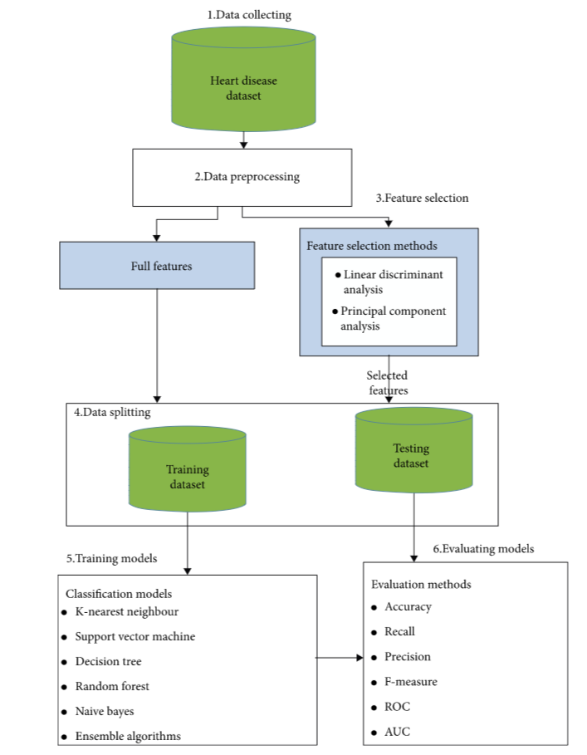
Flow Chart

Slide 8
Process
Data Collection
The heart disease dataset [26] is utilized for training and evaluating models. It consists of 1025 records, 13 features, and one target column. The target column includes two classes: 1 indicates heart diseases, and 0 indicates nonheart disease. Table 1 describes the details of the features.
Data Preprocessing
The features are scaled to be in the interval [0,1]. It is worth noting that missing values are deleted from the dataset.
Feature Extraction (FE)
The extraction of the best features is a crucial phase because irrelevant features often affect the classification efficiency of the machine learning classifier. In this phase, linear discriminant analysis (LDA) [27] and principal component analysis (PCA) [28, 29] are used to select essential features from the dataset.
Data Splitting
In this step, the heart disease dataset is divided into a 75% training set and a 25% as the testing set. The training set is utilized for training the models, and the testing set is utilized to evaluate the models. Also, ninefold cross-validation is utilized in the training set.
Training Models
Different types of machine learning algorithms: KNN, DT, RF, and NB are applied to classify heart disease. Also, two types of ensemble techniques: boosting and bagging are applied to classify heart disease

Slide 9
Process Model
Data Cleanig
3
4
Model Building
2
5
Analysis
KEYS
Evaluating Performance
1
6
Data Collection
Result Analysis

Slide 10
Variables
Numericals
Categorical
Ordinal
Prediction Variables

Slide 11
Model

Slide 12
Models
Decision Tree
Random Forest
perform a ML role that can be utilized for problems with classification and regression.
perform a ML role that can be utilized for problems with classification and regression.
KNN
KNN is a nonparametric technique of lazy learning to enable the prediction of the new sample classification. It is utilized in several groups.
SVM
is one of the most popular Supervised Learning algorithms, which is used for Classification as well as Regression problems.
Logistic Regression
logistic regression is a predictive analysis. Logistic regression is used to describe data and to explain the relationship between one dependent binary variable and one or more nominal, ordinal, interval or ratio-level independent variables.
Naviee Bayes
fundamental probabilistic classifiers that focuses on applying the Bayes theorem with clear assumptions of (naive) independence between the attributes.

Slide 13
Packages
Scatter Point
SK Learn
This python library is helpful for building machine learning and statistical models such as clustering, classification, regression etc
A scatter plot is a diagram where each value in the data set is represented by a dot.
Scipy
Pandaas
SciPy is a scientific computation library that uses NumPy underneath.
SciPy stands for Scientific Python.
Pandas is used to analyze data.
Seaborn
Seaborn is a python library for building graphs to visualise data. It provides integration with pandas.

Slide 14
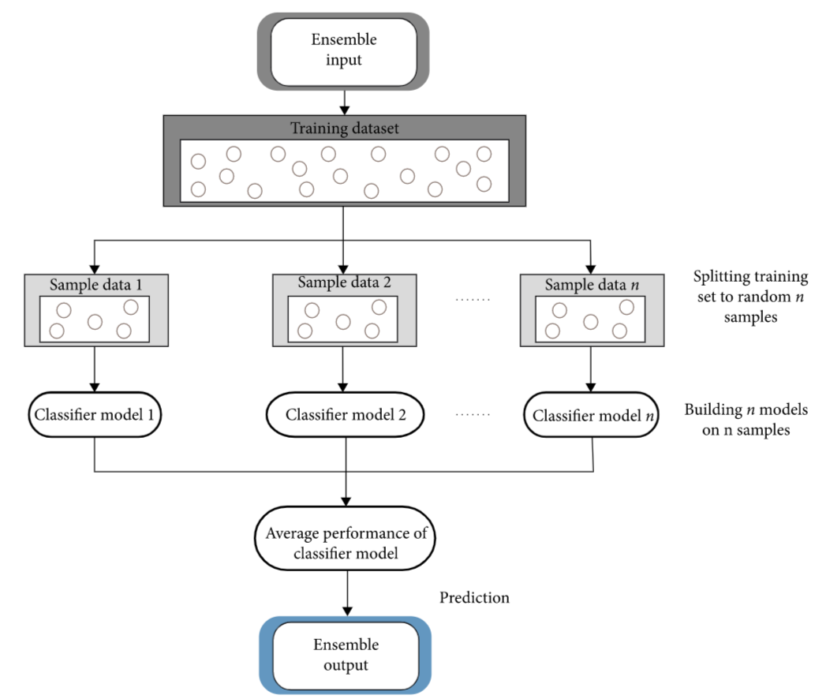
Training

Slide 15
Conclusion

Slide 16
Conclusion
we developed the proposed system to predict heart disease. Ensemble methods (boosting and bagging) with feature extraction algorithms (PCA and LDA) are used to improve predicting heart disease performance. The feature extraction algorithms are used to extract essential features from the Cleveland heart disease dataset. Comparison between ensemble methods (boosting and bagging) and five classifiers (KNN, SVM, NB, DT, and RF) is applied to selected features. The experimental results showed that the bagging ensemble learning algorithm with DT and PCA feature extraction method had achieved the best performance.

Slide 17
Accuracy vs Analysis
Analysis
When ever the analysis is donr the it is passes through the testing of the model .
Accuracy
When ever the accuracy is below 80% then the analysis phase is redone and made a model with accuaracy greater than 80%

Slide 18
THANK YOU

